Slide 1
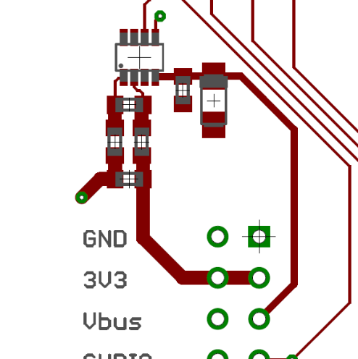
Removing 1R shunt
Either remove the 1R resistor, and then solder across the pads..
OR
Just keep applying solder across the top of the resistor so it becomes one big blob of short circuit!

Slide 2
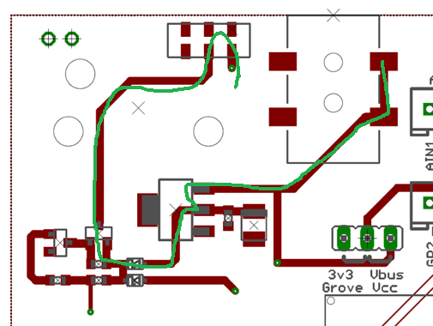
DC Jack Current path
Physical switch, before the power goes into the power plane.
Conclusion
a fairly long path, with some potentially limiting components in it.
BAT60 low-Vf diode, and a PMF170 P-FET. Need to look at their current rating
3v3 from the DAPule merged in through a BAT60
Through an LDO, rated at 800mA.. Same as on the DAPule

Slide 3
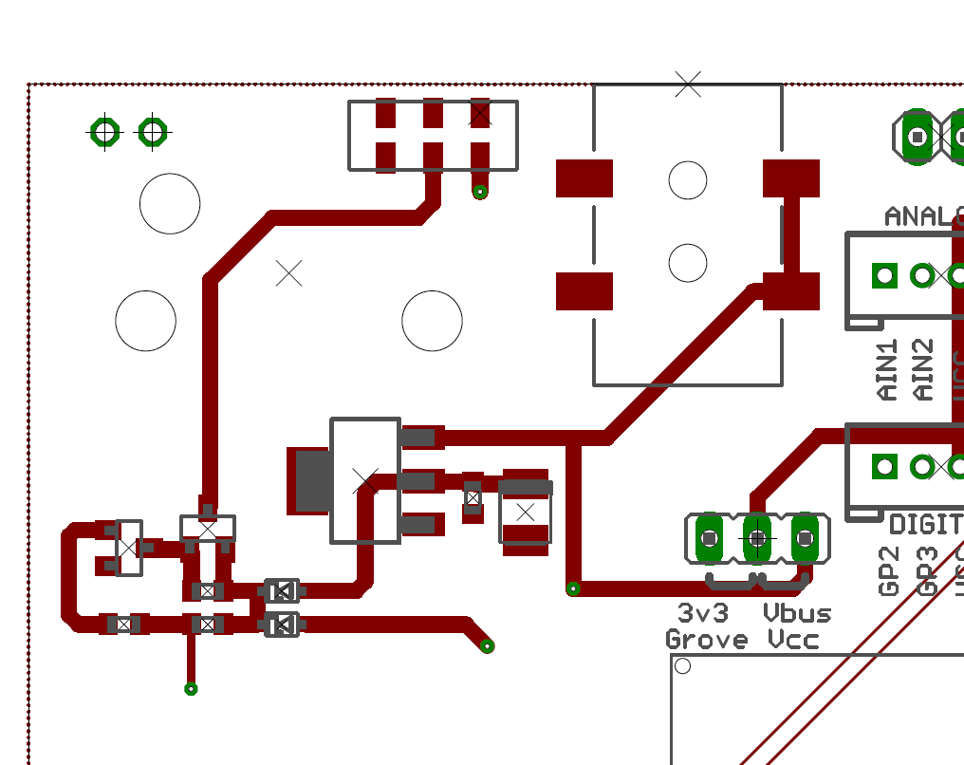
Modifying DC Jack Current path
Cut the path to the switch
Strap directly from the DC connector the switch
3. For the love of god, please use a power supply regulated at 3v3

